Slide 1
Bayesian Classifier
DATA MINING
(Classification Model)

Slide 2
Introduction
Bayesian Theorem is a fundamental statistical approach in pattern recognition.
This approach is based on the trade-off quantification between classification decisions using probability and the risks of the decisions.

Slide 3
Study Case
We have a hypothetical problem to design the classification function for separating 2 fish categories, which are milkfish and snapper.
Both objects are taken into conveyor.
A person is assigned to monitor the objects in the conveyor randomly.
The person wants to predict the next fish in the conveyor.

Slide 4
Solution
There are 2 possible answers: milkfish or snapper.
h₁ = milkfish, h₂ = snapper
If the number of milkfish caught previously is same as the number of snapper, then the probability of both fish is equal.

Slide 5
Solution
Thus prior probability , P(h₁) and P(h₂) defines the probability of each fish.
The prior probability defines the estimation of the predictable fish before it is taken into conveyor.
Even though we don’t know the accurate answer, at least we can estimate them based on the data given.

Slide 6


Solution
Suppose N = the total number of fish caught before taken into conveyor.
N₁ = the number of milkfish, N₂ = the number of snapper, then:
The prediction result is milkfish (h₁) if P(h₁)>P(h₂), or vice versa.

Slide 7
Problems
What if the amount of estimated fish is excessive?
In many cases, the decision is taken using more information, not only from prior probabilities.

Slide 8
Problems
We may use color (x) to increase the prediction accuracy.
Stated in P(x | h), indicates the probability of x if the h value is known.
Thus P(x|h₁) and P(x|h₂) show the differences of color distribution between both fish.

Slide 9
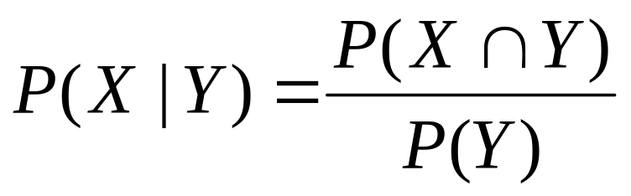
Conditional Probability
S
X
X∩Y
Y
Probability X in Y is the intersection probability of X and Y from the probability of Y. In other words, P(X|Y) is the percentage of the number of X in Y

Slide 10

Conditional Probability
Based on previous case, suppose the prior probability P(h_{j}), and conditional probability P(x|h_{j}), and color (x), thus the posterior probability will be:
P(h_{j}|x) means the probability of h_{j} if we know the value of x.

Slide 11
Conditional Probability
Based on the rule of Bayes, thus will be:
If P(h₁|x) < P(h₂|x), then it will be classified h₂.
If P(h₁|x) > P(h₂|x), then it will be classified h₁.

Slide 12
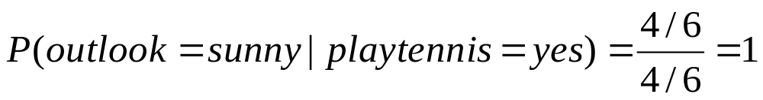
Conditional Probability in Dataset
# | Outlook | Temperature | Wind | Play Tennis?
1 | Sunny | Normal | False | Yes
2 | Sunny | Normal | False | Yes
3 | Rain | High | False | No
4 | Sunny | Normal | True | Yes
5 | Rain | High | True | No
6 | Sunny | Normal | False | Yes
The number of play tennis=yes is 4 out of 6, then:
P(Play tennis = yes) = 4/6
The number of Outlook=Sunny and Play Tennis=yes are 4 out of 6, thus
P(outlook=sunny and Play tennis=yes) = 4/6
If the outlook is sunny, will people play tennis?

Slide 13
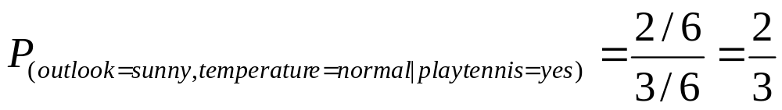
Conditional Probability in Dataset
# | Outlook | Temperature | Play Tennis?
1 | sunny | normal | Yes
2 | sunny | high | yes
3 | hujan | high | no
4 | sunny | high | no
5 | hujan | normal | no
6 | sunny | normal | yes
The number of Play tennis=yes is 3 out of 6 thus:
P_{(Play tennis=yes)} = 3/6
The number of outlook=sunny, temperature=normal and playtennis=yes are 2 out of 6 thus:
P(outlook=sunny, temperature=normal, playtennis=yes) = 2/6

Slide 14
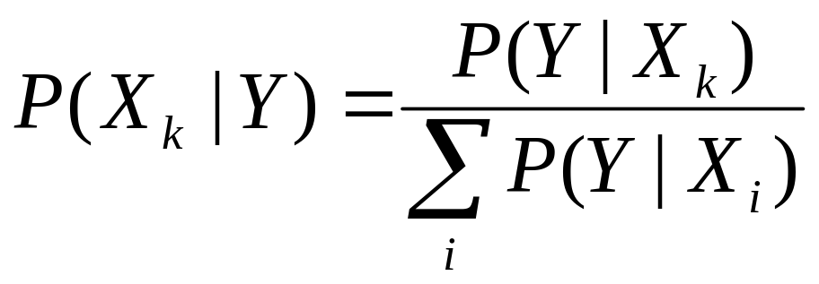
Bayes Algorithm
X₁
X₂
….
X_{n}
Y
Posterior condition (Probability of Xk in Y) can be calculated based on prior condition (Probability of Y in Xk divided by the total of all probability of Y in all Xi)

Slide 15
HMAP
HMAP (Hypothesis Maximum a-Posteriori Probability) defines the hypothesis delivered based on the probability of the existing prior conditions.
P( X | h ).P(h)
P( h | X )
=
P(X)
h_{MAP}
argmax
=
P( h | X )
h∈H
argmax
P( X | h ).P(h)
=
h∈H
HMAP is a simplified model of Bayes a.k.a. Naive Bayes. HMAP is used in machine learning as a tools to find the hypothesis of a decision.

Slide 16
Example of HMAP
Given the results of a survey conducted by a health institution states that 90% of the world's population suffers from lung disease. Of the 90% of the residents with lung disease, 60% are smokers, and those who do not suffer from lung disease are 20% of smokers.
Hypothesis: If anyone knows smoking, does he have lung disease?

Slide 17
Solution
Facts:
X=smokers, Y=suffering lung disease.
Thus: P(Y) = 0.9
P(¬Y) = 0.1
P(X|Y) = 0.6 → P(¬X|Y) = 0.4
P(X|¬Y) = 0.2 → P(¬X| ¬Y) = 0.8
Using Bayes:
P({X}|Y) = P(X|Y).P(Y) = (0.6) . (0.9) = 0.54
P({X}|¬Y) = P(X|¬Y).P(¬Y) = (0.2).(0.1) = 0.02
When someone is known to smoke, then he suffered from lung disease because P({X}|Y) is greater than P({X}|¬Y).
HMAP defines the largest probability of all instances in the target attribute or all possible decisions. On the issue of decision is lung pain or not.

Slide 18
HMAP of Training Data
# | Weather | Temperature | Wind | Play tennis
1 | Sunny | Normal | Slow | Ya
2 | Sunny | Normal | Slow | Ya
3 | Rain | High | Slow | No
4 | Sunny | Normal | Fast | Yes
5 | Rain | High | Fast | No
6 | Sunny | Normal | Slow | Yes
Apakah bila cuaca cerah dan kecepatan angin kencang, orang akan berolahraga?

Slide 19
HMAP Dari Data Training
# | Cuaca | Temperatur | Kecepatan Angin | Berolah-raga
1 | Cerah | Normal | Pelan | Ya
2 | Cerah | Normal | Pelan | Ya
3 | Hujan | Tinggi | Pelan | Tidak
4 | Cerah | Normal | Kencang | Ya
5 | Hujan | Tinggi | Kencang | Tidak
6 | Cerah | Normal | Pelan | Ya
Asumsi:
Y = berolahraga,
X₁ = cuaca,
X₂ = temperatur,
X₃ = kecepatan angin.
Fakta menunjukkan:
P(Y=ya) = 4/6 → P(Y=tidak) = 2/6

Slide 20
HMAP Dari Data Training
# | Cuaca | Temperatur | Kecepatan Angin | Berolah-raga
1 | Cerah | Normal | Pelan | Ya
2 | Cerah | Normal | Pelan | Ya
3 | Hujan | Tinggi | Pelan | Tidak
4 | Cerah | Normal | Kencang | Ya
5 | Hujan | Tinggi | Kencang | Tidak
6 | Cerah | Normal | Pelan | Ya
Apakah bila cuaca cerah dan kecepatan angin kencang, orang akan berolahraga?
Fakta: P(X1=cerah|Y=ya) = 1, P(X1=cerah|Y=tidak) = 0
P(X3=kencang|Y=ya) = 1/4 , P(X3=kencang|Y=tidak) = 1/2
HMAP dari keadaan ini dapat dihitung dengan:
P( X1=cerah,X3=kencang | Y=ya )
= { P(X1=cerah|Y=ya).P(X3=kencang|Y=ya) } . P(Y=ya)
= { (1) . (1/4) } . (4/6) = 1/6
P( X1=cerah,X3=kencang | Y=tidak )
= { P(X1=cerah|Y=tidak).P(X3=kencang|Y=tidak) } . P(Y=tidak)
= { (0) . (1/2) } . (2/6) = 0
KEPUTUSAN BEROLAHRAGA = YA

Slide 21
Accuracy, Recall, Precision
Accuracy didefinisikan sebagai tingkat kedekatan antara nilai prediksi dengan nilai aktual.
Recall adalah tingkat keberhasilan sistem dalam menemukan kembali sebuah informasi.
Precision adalah tingkat ketepatan antara informasi yang diminta oleh pengguna dengan jawaban yang diberikan oleh sistem.

Slide 22
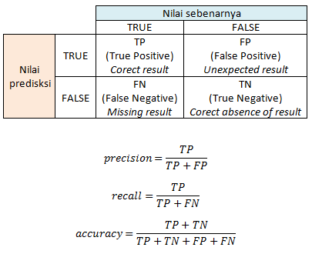
Accuracy, Recall, Precision

Slide 23
Please visit the link
https://www.youtube.com/watch?v=RixQygYyDKI

Slide 24
LATIHAN
# | Warna | Tipe | Asal | Tercuri ?
1 | Merah | Sport | Domestik | Ya
2 | Merah | Sport | Domestik | Tidak
3 | Merah | Sport | Domestik | Ya
4 | Kuning | Sport | Domestik | Tidak
5 | Kuning | Sport | Import | Ya
6 | Kuning | SUV | Import | Tidak
7 | Kuning | SUV | Import | Ya
8 | Kuning | SUV | Domestik | Tidak
9 | Merah | SUV | Import | Tidak
10 | Merah | Sport | Import | Ya
Apakah bila tipe SUV, asal import, kemungkinan besar akan tercuri?
Apakah bila warna merah, tipe sport, dan asal import kemungkinan akan tercuri?

Slide 25
Jawab Soal 1
Apakah bila tipe SUV, asal import, kemungkinan besar akan tercuri?
Asumsi:
Y = Tercuri,
X₁ = warna,
X₂ = tipe,
X₃ = asal.
Fakta menunjukkan:
P(Y=ya) = 5/10 → P(Y=tidak) = 5/10
Fakta: P(X2=SUV|Y=ya) = 1/5, P(X2=SUV|Y=tidak) = 3/5
P(X3=import|Y=ya) = 3/5 , P(X3=import|Y=tidak) = 2/5
HMAP dari keadaan ini dapat dihitung dengan:
P( X2=SUV,X3=import | Y=ya )
= { P(X2=SUV|Y=ya).P(X3=import|Y=ya) } . P(Y=ya)
= { (1/5) . (3/5) } . (5/10) = 15/250 = 3/50
P( X2=SUV,X3=import | Y=tidak )
= { P(X2=SUV|Y=tidak).P(X3=import|Y=tidak) } . P(Y=tidak)
= { (3/5) . (2/5) } . (5/10) = 30/250 = 3/25
HIPOTESIS TERCURI = “TIDAK”

Slide 26
Jawab Soal 2
Apakah bila warna merah, tipe sport, dan asal import kemungkinan akan tercuri?
Asumsi:
Y = Tercuri,
X₁ = warna,
X₂ = tipe,
X₃ = asal.
Fakta menunjukkan:
P(Y=ya) = 5/10 → P(Y=tidak) = 5/10
Fakta: P(X1=Merah|Y=ya) = 3/5, P(X1=Merah|Y=tidak) = 2/5
P(X2=Sport|Y=ya) = 4/5, P(X2=Sport|Y=tidak) = 2/5
P(X3=import|Y=ya) = 3/5 , P(X3=import|Y=tidak) = 2/5
HMAP dari keadaan ini dapat dihitung dengan:
P( X1=Merah,X2=Sport,X3=import | Y=ya )
= { P(X1=Merah|Y=ya).P(X2=Sport|Y=ya).P(X3=import|Y=ya) } . P(Y=ya)
= { (3/5) . (4/5) . (3/5) } . (5/10) = 180/1250 = 0,144
P(X1=Merah,X2=Sport,X3=import | Y=tidak )
= {P(X1=Merah|Y=tidak).P(X2=Sport|Y=tidak).P(X3=import|Y=tidak) }.P(Y=tidak)
= { (2/5) . (2/5) . (2/5) } . (5/10) = 40/1250 = 0,032
HIPOTESIS TERCURI = “YA”

